Slide 1
Theming in Android PhilipsUIKit

Slide 2
Introduction
This presentation explains how theme colors in PhilipsUIKit are defined.
Currently, themes only define colors, nothing else.
In the future, themes may also define other things (e.g. fonts)

Slide 3
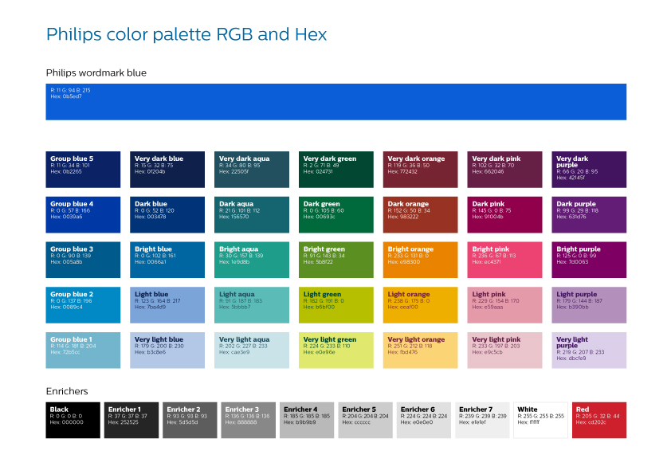
18 themes

Slide 4
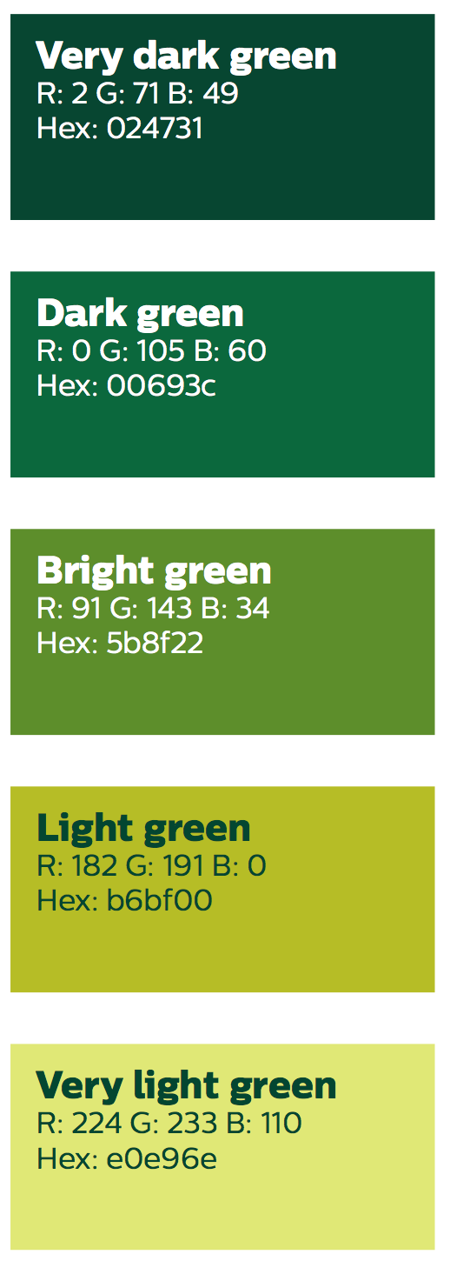
Theme Colors
“bright green”
“dark green”
A theme uses:
Base color
One darker than base color (-1)
One lighter than base color (+1)
Very light color
Theme “very dark” not possible
Theme “very light” not possible
darker
-1
darker
base
-1
+1
base
lighter
+1
lighter
very light
very light

Slide 5
Theme Colors
“Light green”
A theme uses:
Base color
One darker than base color
One lighter than base color
Very light color
Theme “very dark” not possible
Theme “very light” not possible
Theme “light” has same color for “lighter” and “very light”
darker
base
lighter
very light

Slide 6
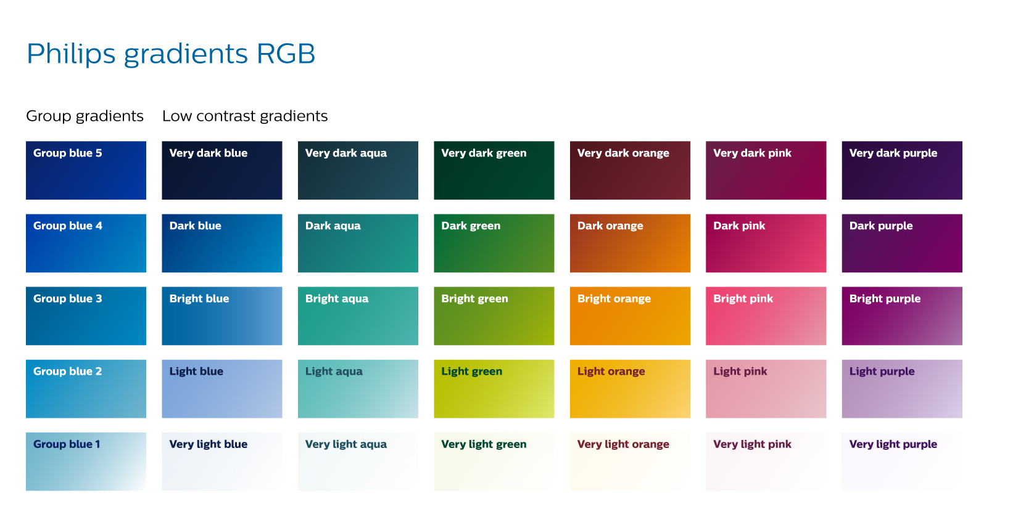
Used in PhilipsUIKit
Theme Gradients

Slide 7
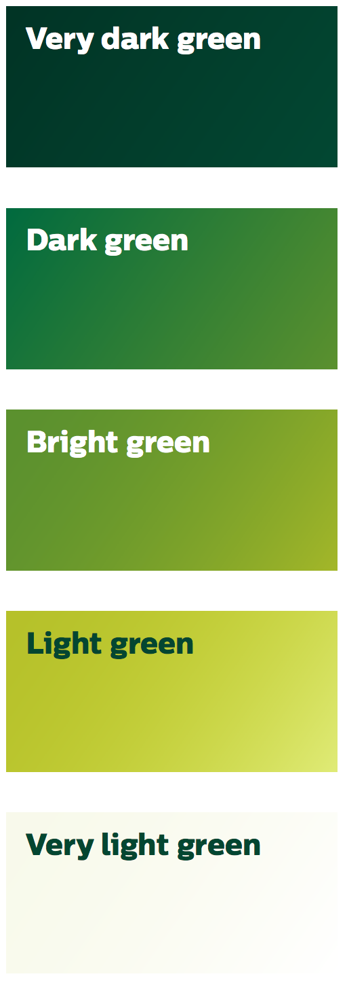
Theme Gradients
Gradients for theme “dark”
A theme uses:
Base gradient (-1)
Darker gradient
Lighter gradient (+1)
Even lighter gradient (+2)
Very light gradient
darker
-1
base
+1
lighter
+2
even lighter
very light

Slide 8
Theme Gradients
Gradients for theme “bright”
A theme uses:
Base gradient (-1)
Darker gradient
Lighter gradient (+1)
Even lighter gradient (+2)
Very light gradient
For “bright” themes:
“even lighter” and “very light” are the same
darker
-1
base
+1
lighter
+2
even lighter
very light

Slide 9
Theme Gradients
Gradients for theme “light”
A theme uses:
Base gradient (-1)
Darker gradient
Lighter gradient (+1)
Even lighter gradient (+2)
Very light gradient
For “bright” themes:
“even lighter” and “very light” are the same
For “light” themes:
“even lighter”, “very light” and “light” are the same
darker
-1
base
+1
lighter
even lighter
very light

Slide 10
Code
Every color property is derived from these four colors and five gradients
Attrs.xml
<attr name=“uikit_baseColor" format="reference|color"/>
<attr name=“uikit_verydarkBaseColor" format="reference|color"/>
<attr name=“uikit_veryLightColor" format="reference|color"/>
<attr name=“uikit_brightColor" format="color" />
<attr name=“uikit_LightColor" format="reference|color"/>
<attr name=“uikit_darkerColor" format="reference|color"/>
<attr name=“uikit_gradWindowBackground" format="reference|color"/>
<attr name=“uikit_baseGradient" format="reference"/>
<attr name=“uikit_darkerGradient" format="reference"/>
<attr name=“uikit_lighterGradient" format="reference"/>
<attr name=“uikit_evenLighterGradient" format="reference"/>
<attr name=“uikit_veryLightGradient" format="reference"/>

Slide 11
Custom Theme Creation From Scratch
Defining attribute for components can give the desired color , for example a textview text color has to be set to a darker color than base color then we can do it like below but giving text color as attribute of darkerColor;
<TextView
android:id="@+id/textView1"
android:layout_width="wrap_content"
android:layout_height="wrap_content"
android:text="TextView"
android:textColor="?attr/uikit_darkerColor"
android:textSize="16sp" />

Slide 12
Summary
There are 18 themes:
Six colors: blue, aqua, green, orange, pink, purple
Three variants: dark, bright and light
A theme contains:
Four colors:
Base
Darker
Lighter
Very light
Five gradients:
Base
Darker
Lighter
Even lighter
Very light
All theme properties are derived from these
Themes can be customized by copying an existing one and overriding properties
Themes can be constructed from scratch by defining four colors and five gradients

